Slide 1
CELL GROWTH, DIVISION & DIFFERENTIATION

Slide 2

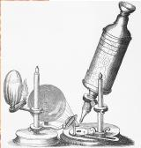
Introduction of cell biology
Cell biology
The branch of biology dealing with the study of structure, function, molecular organization, growth, reproduction and genetics of the cells, is called cytology or cell biology.
The discovery of the cells
• 1665 - Robert Hooke looks at cork
under a microscope. Calls the chambers
he see "cells"

Slide 3
Cells arise from the division of other cells
•Daughter cells inherit the genes from the mother cells
•Daughter cells inherit cytoplasm and organelles from the mother cells
•Binary fission - cell division in bacteria
•Mitosis - The genetic complement of each daughter cell is identical to the other and to the mother cell.
•Meiosis - The genetic complement of each daughter cell is reduced by half.

Slide 4
CELL CYCLE
A cell cycle is a series of events that takes place in a cell as it grows and divides.

Slide 5
CELL CYCLE
The cell cycle of the eukaryotic cell is divided into two fundamental parts:
i. Interphase, and
ii. Mitosis (including Cytokinesis)

Slide 6
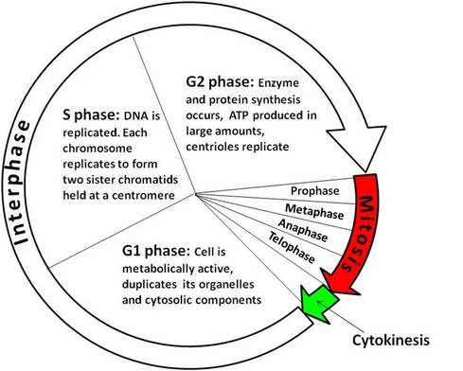
CELL CYCLE
Stages

Slide 7
CELL CYCLE
There are three stages of interphase: G₁ (first gap), S (synthesis of new DNA ), and G₂ (second gap).
Cells spend most of their lives in interphase, specifically in the S phase where genetic material must be copied.
The cell grows and carries out biochemical functions, cell is metabolically active, in the G₁ phase.
In the G₂ phase, energy is replenished, new proteins are synthesized, and additional growth occurs.

Slide 8
CELL DIVISION
Cell division is the process by which a parent cell divides into two or more daughter cells.
It is of two type:
Mitosis- Division take place in somatic cells (any cell of a living organism other than the reproductive cells- muscle cells, blood cells, skin cells and nerve cells)
Meiosis- Division take place in reproductive cell (a cell responsible for transmitting DNA to the next generation)

Slide 9
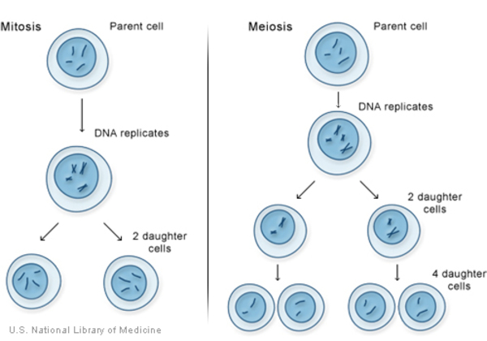
Differences

Slide 10
Mitosis
A type of cell division that results in two daughter cells each having the same number and kind of chromosomes as the parent nucleus, typical of ordinary tissue growth. It is also known as equational division. Phases of Mitosis
Prophase
Metaphase
Anaphase
Telophase

Slide 11
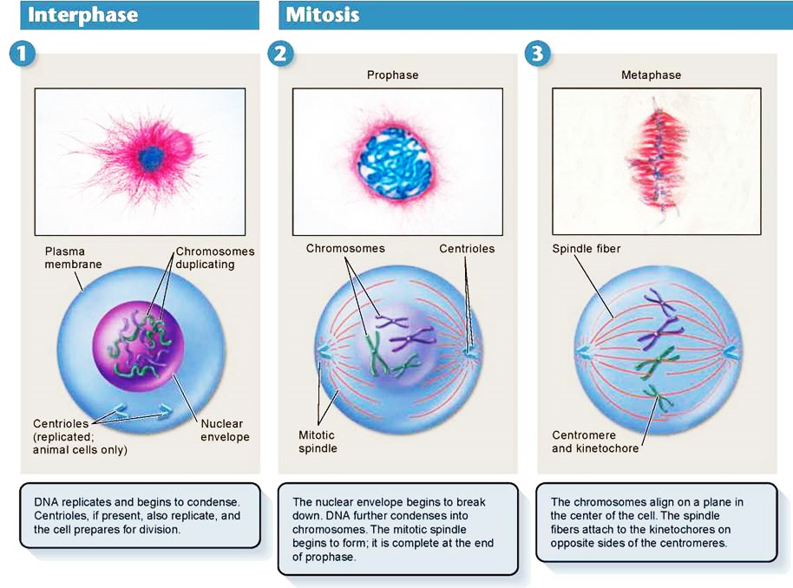

Slide 12
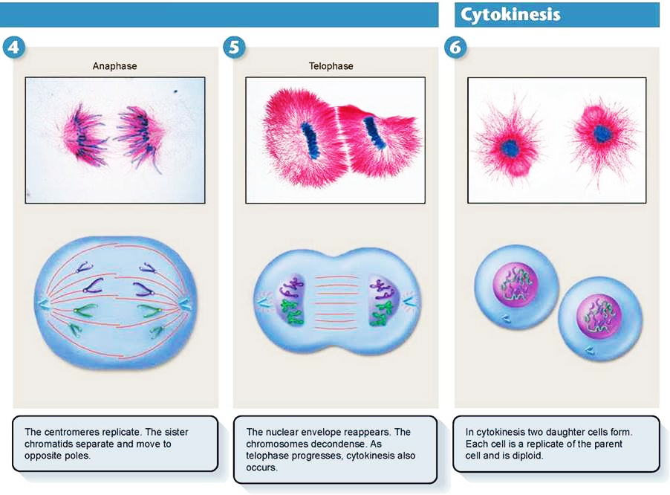

Slide 13
Meiosis
Meiosis is a double division which occurs in a diploid cell and give rise to four haploid cells each having half the number of chromosomes as compared to the parent cells. It is also known as reductional division.
Two divisions:
Meiosis I and
Meiosis II

Slide 14
Meiosis I
Meiosis I is a reduction division
Four phases
Prophase I
Metaphase I
Anaphase I
Telophase I

Slide 15
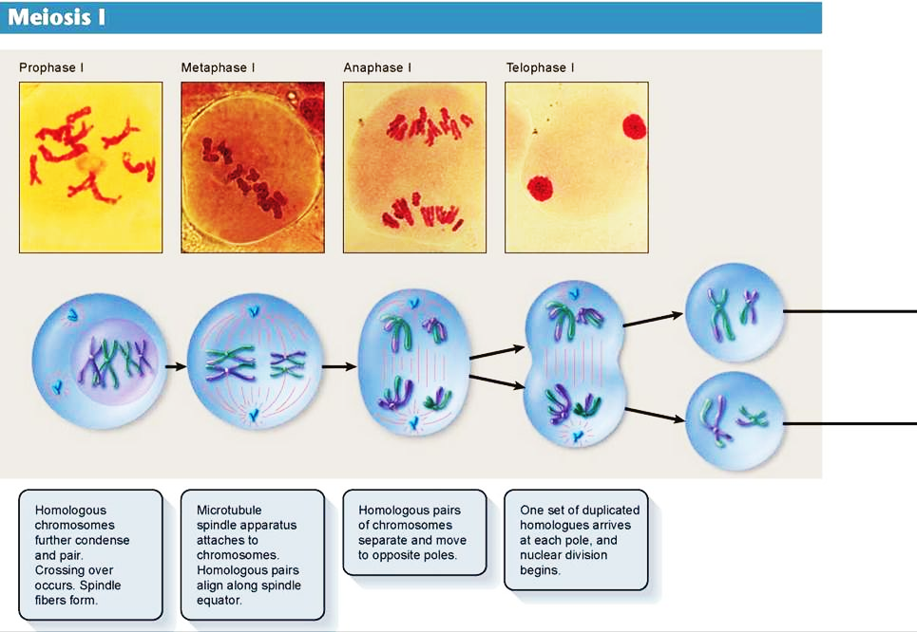

Slide 16
Meiosis II
Meiosis II is a equational division
Four phases:
Prophase II
Metaphase II
Anaphase II
Telophase II

Slide 17
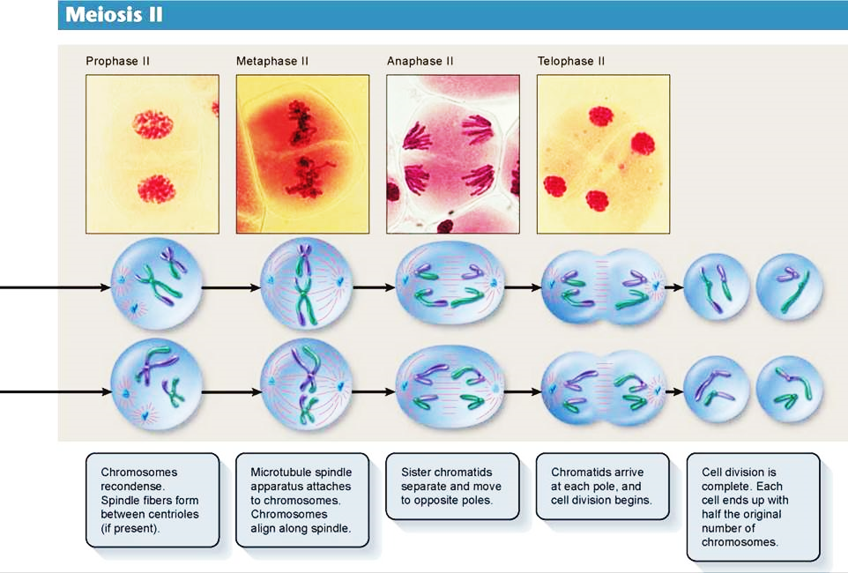

Slide 18
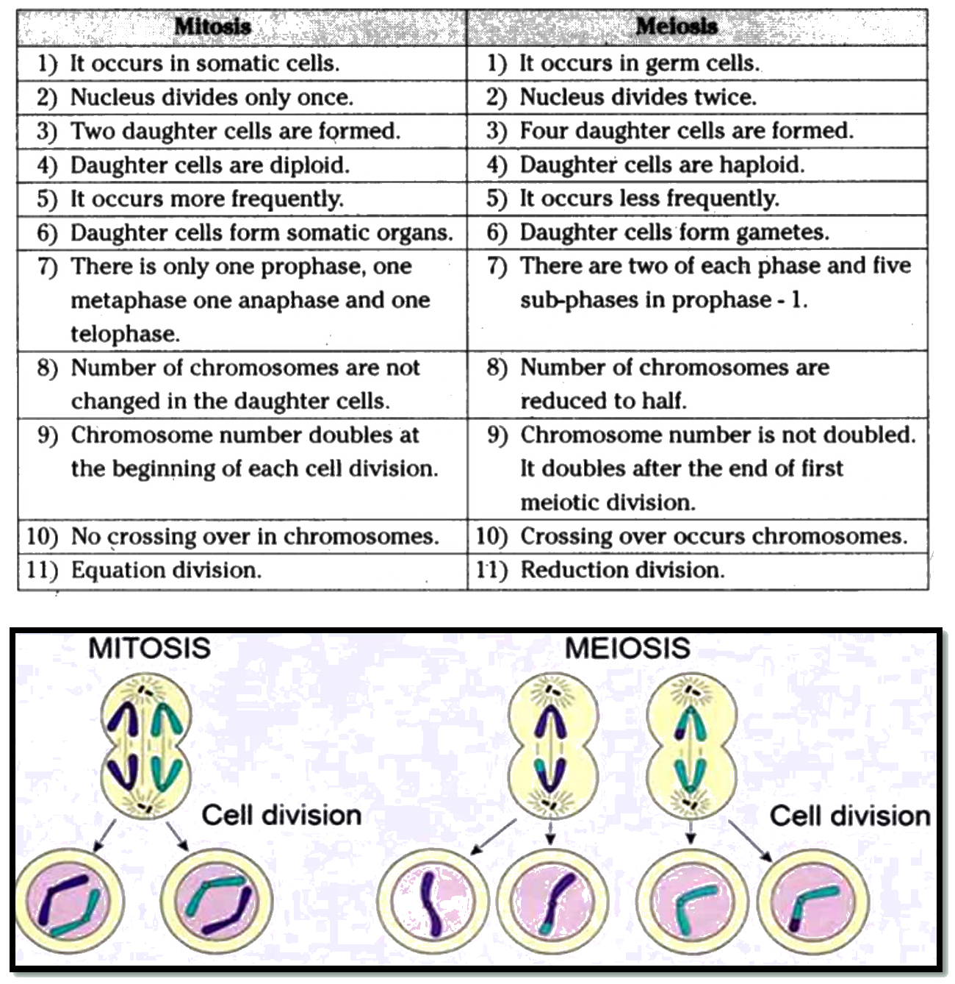

Slide 19
Significance and importance of mitosis
Growth of organisms via new cells
Hereditary material equally distributed in daughter cell.
Genetic information remain unchanged
Involved in regeneration, healing of wound and replacement of older cells.
Involved in development and growth of multicellular organisms.
Replace dead and damaged cells.
Involved in cloning and culturing.

Slide 20
Significance and importance of meiosis
Essential for reproduction in organisms
It activates the genetic information
Meiosis is of great importance in evolution
It enables genetic diversity
It repairs genetic defects
New genetic combination in next generation

